Slide 1
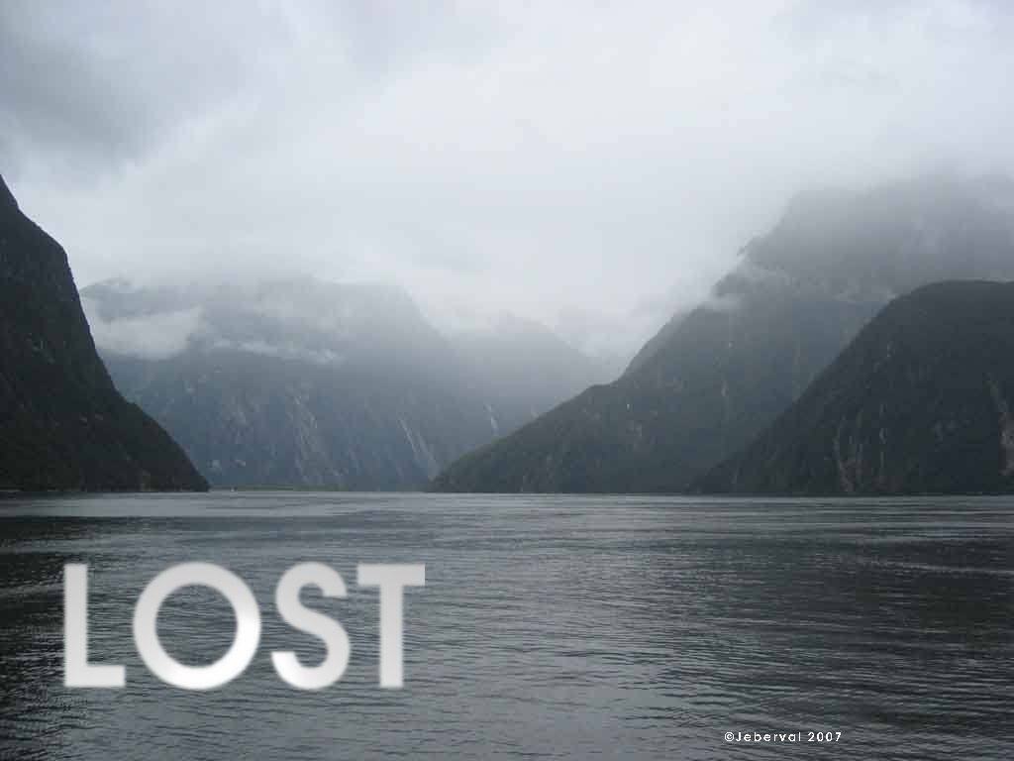
Lost Island
By Usman Basharat

Slide 2
Characters
Back Story
Objectives
Gameplay
Visual Style
Genre
Target Audience
Unique Selling Point
WHAT I AM GOING TO DO?

Slide 3
Characters
MAGICIAN- The last option throughout the game would be the magician. It uses spells to punish enemies for its survival. All of the characters would look the same. The image is to present how the character would roughly look like. It would looks similar like the ranger.
ARCHER- This is a ranger. Again, another option for the user to use. It will have a bow and some arrow. It will use the arrows to kill enemies when threatened. The aim of the game is to survive. The user must choose the best character for them to survive. If the user is about to die, it can use a sword to defend itself. However, the sword after the battle will automatically disappear.
WARRIOR- In my game, they will be a warrior where the user has a choice to dress the character. It will only use melee as the attacking option. They won’t be any magic or ranging option. They can use other defences with melee option by using a defender to defend itself when battling an enemy.

Slide 4
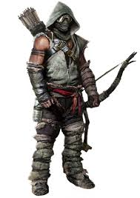
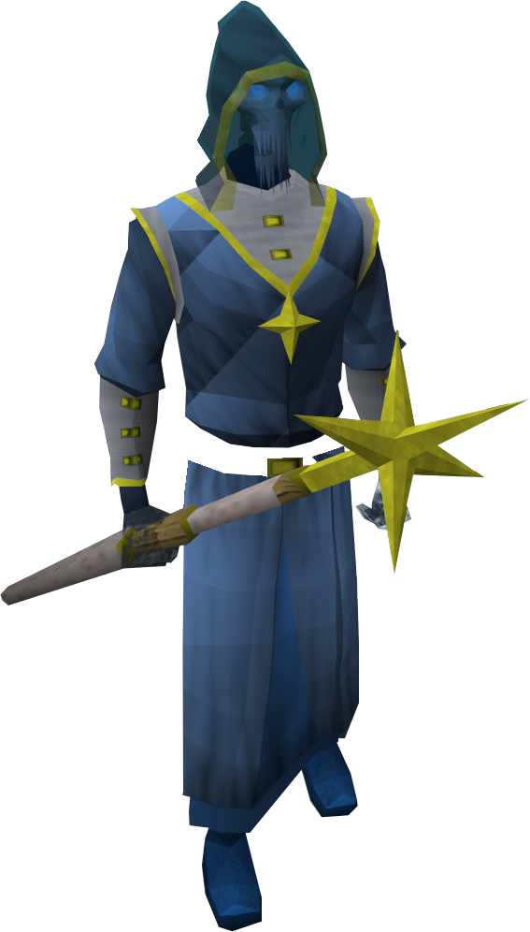
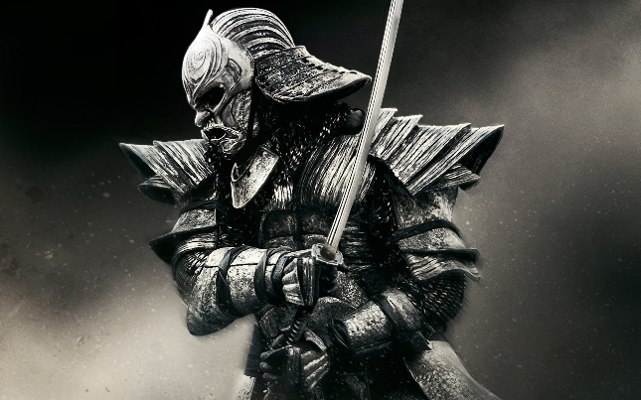
PICTURES OF CHARACTERS

Slide 5
Back Story
The story is based on a person being lost. David was a boy, around 9 years old, when departed his parents on a cruise to New York. He got lost on an island where his parents never knew whereabouts he was. During his time, he found a good friend where he told a ‘mini’ story to David. He told him that he has to be a success during his time and gave him three options to be a hero: magician, archer or warrior. He never was forced into being a hero. The old man persuaded him to do it. He told him old stories of his time for being a hero.
One of these cities, he will find his parents. Once this is complete, the user will be rewarded. David is another player, so if the user is in need, he can use David to help him.
The old man had told him that there is a ‘lost world’ in the five countries: USA, UK, Germany, France and Spain. In one of these, you will have fight of the powerful dragons who have been destroying lives. It was up to David…unfortunately, the old man had passed away. Having been told from the old man, it was up to David to sort out ‘lost world’.

Slide 6
Gameplay
The game starts off with a lost boy that has lost his parents during a trip to New York. He doesn’t know how he got there. This is an animated mini-story, giving a summary of the game.
It will start with a brief cut-scene where the user has to understand the back story of the player. Therefore, how he got on the island; when he got there. It will show subtitles so the user can read what has happened
The only weapons that David has is a boat and a knife. He can use the boat, but he will get attacked on the way. He has to survive the vital part of the game.
Once he has survived, he gets to choose where to go: USA, UK, France, Germany or Spain. Each player has available to upgrade- strengths, defence, attack. These three are key as there upgrades depend on which character they choose. The player has a minimum of 3 lives. Once these three lives are over, the player has to restart the game. However, the player can pick up more lives once they reach the city. The player lives like a normal person in the city.

Slide 7
MAPS
The maps differ from where the user wants to go. This lets the user experience different maps, as it would be repetitive and boring if we only have one map. The maps that I will be naming, it will relate to the ‘real world’ to make it realistic. They will have different signs to the worlds the user will be choosing. It will show whereabouts the maps will be to demonstrate which one the user wants to go. The island is stuck in the middle of nowhere. It will consist of plain sand and beach with a palm tree. The maps that I will include is the following:
New York, USA
England, UK
Barcelona, Spain
Paris, France
Bayern, Germany

Slide 8
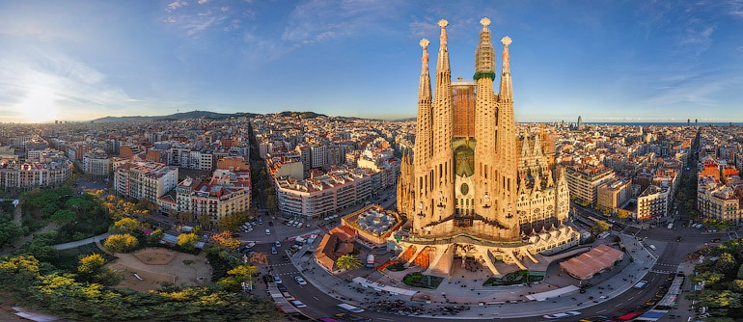
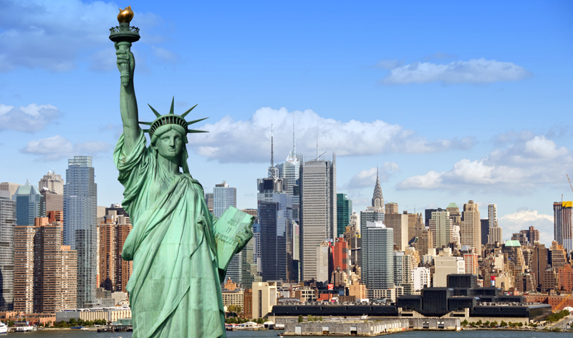
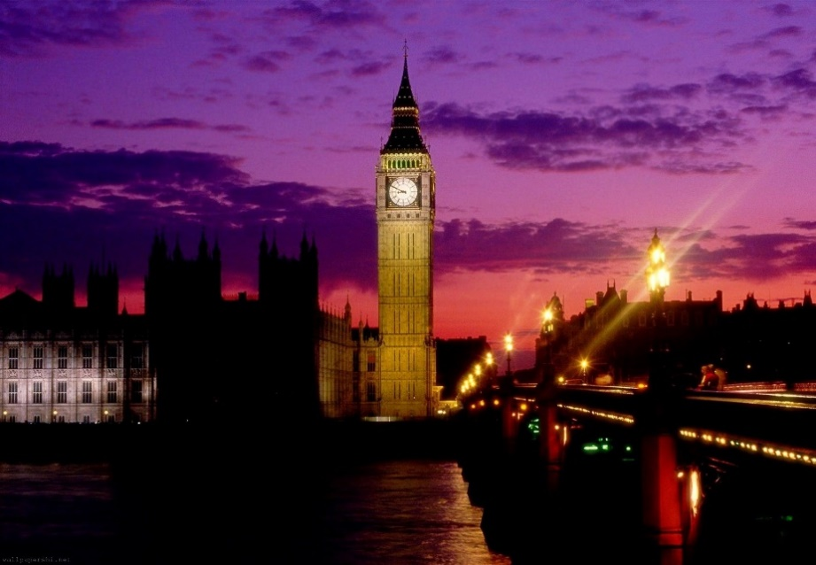
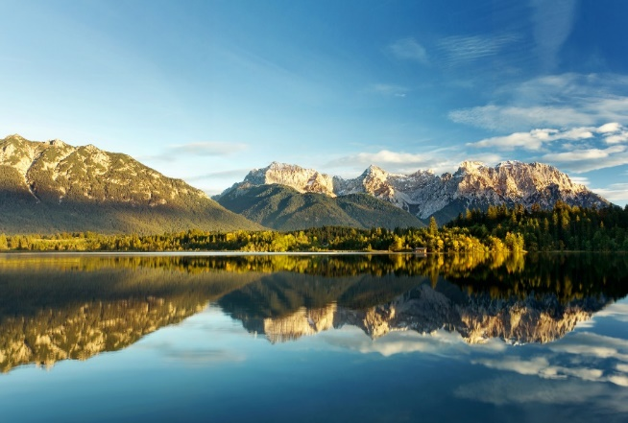

Slide 9
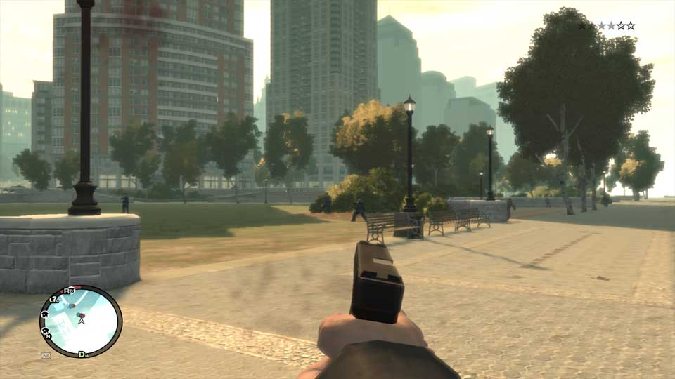
Visual Style
Look of the characters
Game world – terrain, architecture, objects
Scrolling
First Person/Third Person

Slide 10

Objective
The main objective of this game is survival. If you survive, you can enter new objectives e.g. find your parents. You will be attacked by numerous of enemies that you have. They are enemies because they are jealous of you. They want to be superior to you. Therefore, they want you dead.
Another objective is to help others out. Anyone in need, they would need to solve their problem and also get reward for it. They do not have to solve missions to make a living. They can do whatever they want in the game.

Slide 11

Unique Selling Point
The unique selling point (USP) for my game is that it differs from others. It is versatile. It gives the users that other games does not give. It gives a lesson that people can learn from. It gives others a lesson that they can apply to real life e.g. how to build a house.

Slide 12

Target Audience
The target audience is aimed at people who are over the age of 12. it would not be appropriate for YOUNG child (12-) to play this game. It involves missions that young child should not play. It would attract 12 and over because they are the type that play these games.

Slide 13

Genre
The genre of this game is action and adventure. It could relate to the theme of spy but the main genre is action and adventure. It is action, because they will be a lot of action and the player using weapons, throughout the game to kill the enemies. It is adventurous because the player has to find his parents anywhere in the named planets. Whilst he tries to find his parents, he comes across new quests. This makes it adventurous.

Slide 14


Slide 15
Thank you for listening to my presentation

